Slide 1
IBM University Engagement Project Submission
“Exploring the Power of Agentic AI with IBM Granite and LangFlow”

Slide 2
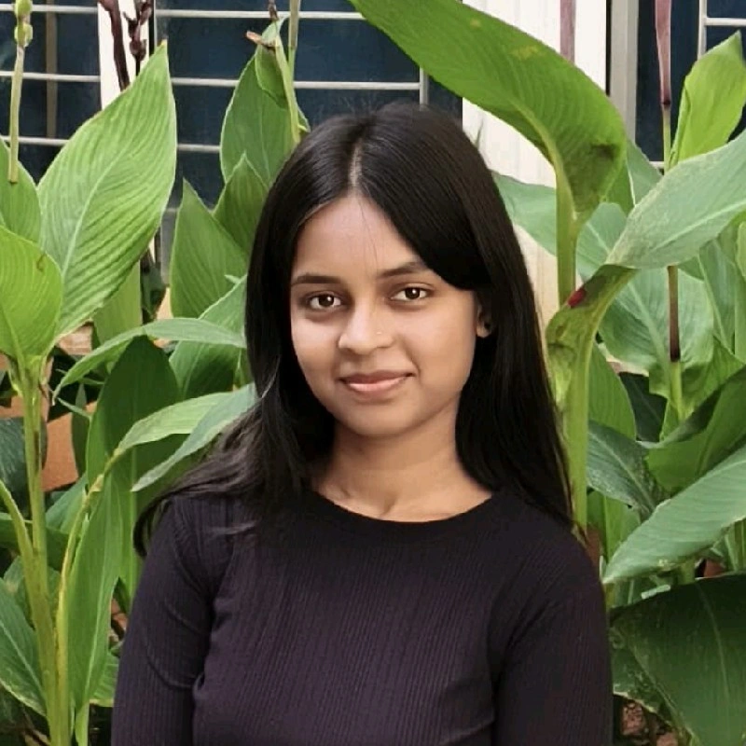
Project Tile – [Nutrition Agent]
Domain of Project – [ Healthcare ]
Student Name | Recent Passport Photo | Email ID | Mobile number [WhatsApp]
Bhagyashree Goudar |  | bhagyashreegoudar439@gmail.com | 9902230702
Recommended font style and size: Font Style: Arial Font Size (Heading): 28
Font Size (Content): 20

Slide 3
Problem Statement - 8
Problem Statement : Nutrition Agent
The Challenge - In an era where health awareness is growing, individuals increasingly seek personalized
nutrition guidance. However, most existing tools provide generic diet plans, lack real-time adaptability,
and fail to consider a person's holistic lifestyle, cultural preferences, allergies, and evolving health
conditions. Furthermore, dieticians and nutritionists face limitations in scaling personalized
consultations due to time and resource constraints.
Generative AI presents a groundbreaking opportunity to revolutionize this space by enabling an
intelligent, interactive, and adaptive virtual nutrition assistant. By leveraging natural language
processing (NLP), multimodal understanding, and large-scale dietary databases, an AI-powered assistant
can generate dynamic meal plans, recommend smart food swaps, and explain nutritional choices—all
tailored to the individual.
This project aims to develop “The Smartest AI Nutrition Assistant” using state-of-the-art generative AI
models that:
• Understand user inputs via text, voice, or image (e.g., food photos, grocery labels)
• Generate personalized meal plans based on health goals, medical conditions, fitness routines,
and preferences
• Offer contextual explanations (e.g., “Why is this food better?”)
• Adapt suggestions dynamically with continuous feedback
By integrating health data, food databases, and LLM-powered reasoning, the solution will bridge the gap
between one-size-fits-all diet apps and in-person nutrition counselling—delivering an AI that thinks,
learns, and cares like a real nutrition expert.

Slide 4
Proposed Solution -
The proposed solution is an AI-Powered Nutrition Agent built using IBM watsonx.ai, IBM Granite, IBM BOB, Python Flask, and Bootstrap to provide personalized, real-time nutrition guidance. The system addresses challenges in diet planning, nutrition tracking, and healthy lifestyle management through an intelligent and interactive AI-powered assistant.
The solution leverages IBM Granite models through IBM watsonx.ai to generate personalized meal plans, answer nutrition-related queries, recommend smart food swaps, and provide contextual explanations based on user preferences, health goals, dietary habits, allergies, and medical conditions.
The system consists of the following key modules:
AI Nutrition Assistant provides real-time nutrition guidance and answers user queries using IBM Granite.
Personalized Meal Planner generates customized meal plans based on age, health conditions, dietary preferences, fitness goals, and lifestyle.
Health & Nutrition Analyzer calculates BMI and TDEE, provides calorie recommendations, and supports healthier food choices.
Food Analysis & Feedback Module allows users to interact through text, voice, or food image uploads, delivers nutrition analysis, recommends smart food swaps, and adapts future recommendations based on user feedback.
The solution includes a responsive dashboard that displays personalized meal plans, nutrition insights, BMI & TDEE calculations, family nutrition profiles, and daily health tips through an intuitive user interface.
IBM watsonx.ai enables AI-powered model deployment, IBM Granite powers reasoning and personalized recommendations, and IBM BOB orchestrates the Nutrition Agent workflow and user interactions.

Slide 5
Technology Used
IBM BOB – Used to build and orchestrate the AI-powered Nutrition Agent, enabling personalized user interactions and intelligent nutrition assistance.
IBM Granite Model (e.g., meta-llama/llama-3-3-70b-instruct or the Granite model you actually used) – Used for natural language understanding, personalized meal planning, nutrition reasoning, contextual explanations, and smart food recommendations.
IBM watsonx.ai – Used to access and deploy foundation models, enabling AI-powered nutrition guidance and conversational responses.
IBM Cloud Lite – Provides the cloud environment for securely developing, testing, and running the Nutrition Agent.
Python Flask – Used to build the backend APIs, manage application logic, user sessions, meal planning, BMI & TDEE calculations, and AI integration.
Bootstrap 5, HTML, CSS & JavaScript – Used to build a responsive and interactive user interface with chat, dashboard, meal planner, voice input, and food image upload features.
Session-based Feedback System – Stores user preferences during the active session to provide adaptive nutrition recommendations and improve subsequent AI responses.

Slide 6
Components Used -
Chat Input – Accepts user queries, health goals, dietary preferences, and nutrition-related questions through text, voice, or food image input.
IBM watsonx AI Agent (IBM BOB) – Processes user inputs and orchestrates the Nutrition Agent workflow to generate personalized nutrition guidance.
Foundation Model – Meta Llama 3.3 70B Instruct (or replace with the exact model currently configured in your .env if different) – Used for natural language understanding, meal planning, nutrition reasoning, and personalized recommendations.
Chat Output – Displays AI-generated meal plans, nutrition analysis, smart food swaps, contextual explanations, and health recommendations.
File/Image Upload – Allows users to upload food images for nutrition analysis. If automatic recognition is unavailable, the user can manually enter the food name for AI-powered analysis.
Session Memory / Feedback Component – Stores user preferences and feedback during the current session to support adaptive nutrition recommendations and personalized responses.

Slide 7
Langflow workflow -
User
│
▼
Chat Input
(Text / Voice / Food Image)
│
▼
IBM BOB Nutrition Agent
│
▼
IBM Granite Model (watsonx.ai)
│
│──────────│
▼ ▼
Meal Planner Nutrition Q&A
│
│────────┤
▼
BMI & TDEE Calculator
│
▼
Smart Food Swaps
│
▼
Adaptive Recommendation
(User Feedback)
│
▼
Chat Output

Slide 8
Architecture blueprint
+----------------------+
| User |
+----------+-----------+
|
+-----------------+-----------------+
| |
Text / Voice Food Image
| |
+---------------+-------------------+
|
IBM BOB Agent
|
IBM watsonx.ai
|
IBM Granite Model
|
+ ------------------ + ------------- + ---------- + ------------ +
| | | | |
Meal Planner BMI/TDEE Food Swaps AI Chat Nutrition Tips
| | | | |
+ ------------------ + ------------ + ---------- + ------------ +
|
Adaptive Feedback
|
Flask Backend
|
Bootstrap Web UI

Slide 9

Role of Agentic AI in the solution
Agentic AI enables the Nutrition Agent to act as an intelligent, goal-oriented assistant rather than a basic chatbot. Using IBM BOB, IBM watsonx.ai, and IBM Granite, the agent understands user inputs, reasons over nutrition-related queries, and generates personalized recommendations.
The AI agent collects user information such as age, dietary preferences, health conditions, fitness goals, BMI, and TDEE to create customized meal plans, nutrition advice, and smart food swap recommendations. It also supports text, voice, and food image interactions, making the system more interactive and user-friendly.
The agent provides context-aware responses, explains nutritional choices, and adapts recommendations based on user preferences and feedback during the session. This enables more personalized and meaningful nutrition guidance.
Overall, Agentic AI makes the Nutrition Agent intelligent, adaptive, and user-centric, helping users make healthier food choices and maintain a balanced lifestyle through AI-powered assistance.

Slide 10
Novelty and Uniqueness
The proposed AI-Powered Nutrition Agent combines IBM watsonx.ai, IBM Granite, IBM BOB, and personalized nutrition intelligence into a single interactive platform.
AI-Powered Nutrition Guidance – Uses IBM Granite models to answer nutrition queries, generate meal plans, and provide health recommendations.
Hyper-Personalization – Creates personalized diet plans based on user goals, health conditions, dietary preferences, BMI, and TDEE.
Multimodal Interaction – Supports text, voice, and food image inputs for a more natural user experience.
Smart Food Analysis & Swaps – Analyzes food nutrition, explains nutritional value, and recommends healthier food alternatives.
Adaptive Recommendations – Uses user feedback during the session to improve future meal and nutrition suggestions.
Preventive Healthcare Focus – Encourages healthy eating habits through disease-specific meal plans, nutrition education, and lifestyle recommendations.
IBM AI-Powered Solution – Built using IBM watsonx.ai, IBM Granite, IBM BOB, and IBM Cloud for secure, scalable, and intelligent nutrition assistance.

Slide 11
Git Hub Link
https://github.com/bhagyashree-goudar/Nutrition-Agent
Live deploy link
https://nutrition-agent-teal.vercel.app

Slide 12
Future Scope
1. Integration with Wearables & Health Devices
Integrate with smartwatches and fitness trackers to collect real-time health data such as steps, calories burned, heart rate, sleep patterns, and activity levels.
Use this data to generate more accurate and dynamic nutrition recommendations.
2. Automatic Food & Grocery Label Recognition
Enhance the Nutrition Agent with advanced AI vision capabilities to automatically recognize food items and grocery labels from images.
Provide instant nutrition analysis, ingredient detection, allergen alerts, and healthier alternatives without requiring manual food entry.
3. Long-Term Personalized Health Tracking
Store user nutrition history and feedback securely to continuously improve meal plans and recommendations.
Track long-term progress toward fitness and health goals with personalized insights.
4. Integration with Healthcare Professionals
Enable secure sharing of nutrition reports with dietitians and healthcare providers for personalized consultation and monitoring.
·
·
·

Slide 13
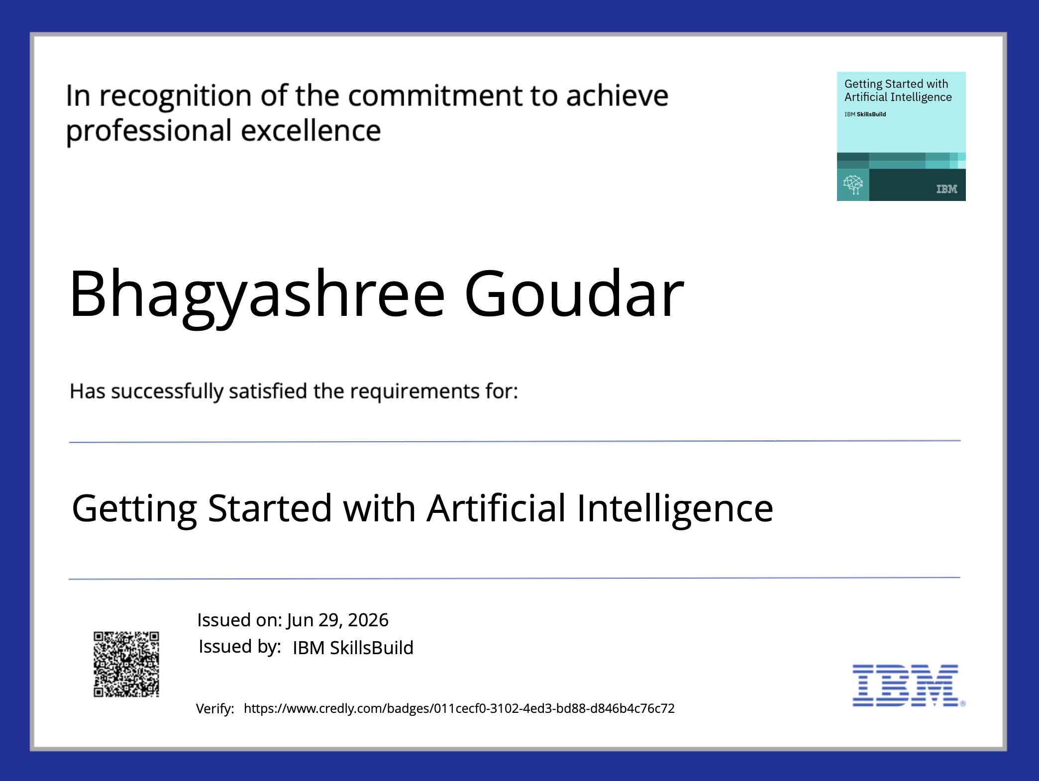
Certificates Earned:
Please add your credly certificate

Slide 14
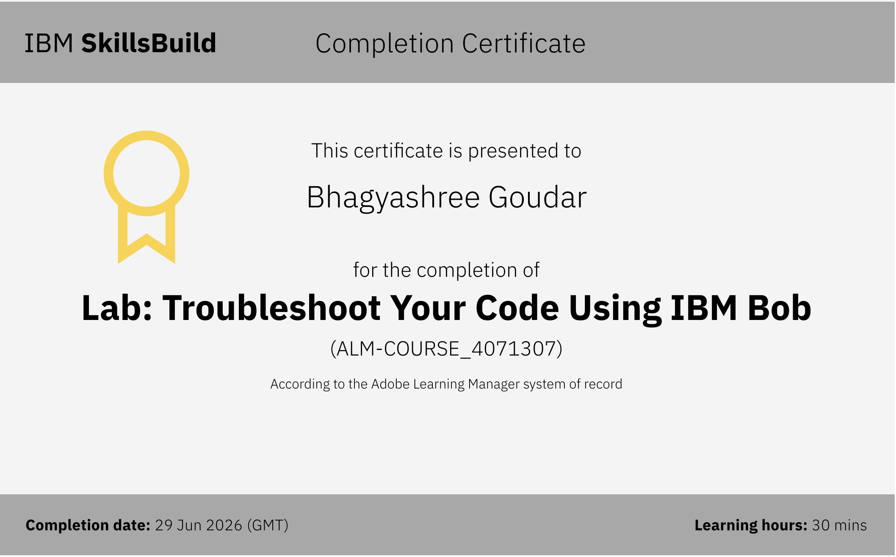
Certificates Earned:​
Add your IBM BOB Certificate

Slide 15


